Slide 1
Region II-III Reforestation Review
August 11, 2016

Slide 2
Purpose
To review and update the Forest Resources & Practices Act reforestation standards for Interior (III) and Southcentral Alaska (II)
To identify high priority research needs for reforestation

Slide 3
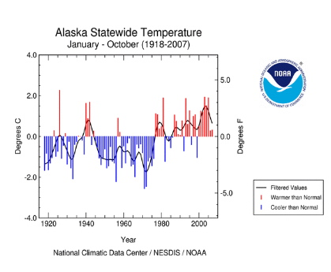
Why now?
Original focus on Coastal Alaska (1993)
Experience
New information
Changing climate

Slide 4
S&TC
Compile & synthesize info
Review standards & recommend changes where appropriate
ID research needs
BOF charge
(Nov. 2013)
Implementation Group
Review recommendations
Advise on practical implementation and consider economics
Draft regulation changes where needed
Prioritize research needs
BOF review
(Nov. 2015)
BOF review
(Aug. 2016)
Implementation

Slide 5
BOF charge
S&TC
BOF review
Implementation Group
BOF review
Phase III: Implementation Actions
Regulations
DPO forms
Implementation fieldbook
Training
Research and coop planning: Winter meeting

Slide 6
Basis for recommendations: S&TC and Implementation Group reviews and findings

Slide 7
Science & Technical Committee
Roger Burnside, DNR-DOF (retired)
Jim Durst, ADF&G-Habitat, co-chair
Marty Freeman, DNR-DOF, co-chair
Nancy Fresco, UAF-SNAP
Julie Hagelin, ADF&G-Wildlife Cons.
Doug Hanson, DNR-DOF
Teresa Hollingsworth, UAF/USFS-BECRU
Glenn Juday, UAF
Nick Lisuzzo, USFS-S&PF
Mitch Michaud, USFS-Chugach NF [ex-NRCS]
Tom Paragi, ADF&G- Wildlife Cons.
Will Putman, Tanana Chiefs Conf.
Hans Rinke/John Winters, DNR-DOF
Amanda Robertson, USFWS
Trish Wurtz, USFS-S&PF
John Yarie, UAF
Brian Young, Landmark Coll. [DOF/USFS]
Notes:
State and federal agencies, universities

Slide 8
Implementation Group
Rod Arno, AK Outdoor Council
Joe Bovee, Ahtna Inc.
Theo DeLaca, Future Forests
Clare Doig, Forest & Land Mgmt. Inc.
Jeremy Douse, Tanana Chiefs Conference
Jim Durst, ADF&G-Habitat
Marty Freeman, DNR-Forestry
Rick Jandreau, DNR-Forestry
Tim Kalke, Sustainable Energy for Galena
Kevin Meany, DNR-Forestry
Amy O’Connor, AK Center for the Environment
Tom Paragi, ADF&G-Wildlife
Jeff Selinger, ADF&G-Wildlife
Paul Slenkamp, Mental Health Trust
Mark Stahl, Denali Log & Lumber
Wade Wahrenbrock, Kenai Peninsula Borough
Joe Young, Young’s Timber, Inc.
Notes:
Forest landowners, planters, consulting foresters, loggers, processors. implementing agencies, environmental and wildlife groups

Slide 9
Literature review - Bibliography
Notes:
495 references

Slide 10
Background findings: Key concepts
Continued seedling recruitment
Factors predicting likely natural regeneration success
Seed bed conditions
Minimal soil disturbance in areas of vegetative reproduction
Seed source availability
Low risk of vegetative competition (esp. grass)
Low herbivory pressure
Not spruce beetle infested, not Tomentosus root rot
Notes:
Findings-Recommendations-Research needs
The NR factors are incorporated into the DPO as a checklist for background information

Slide 11
Key concepts, cont.
Southern seed sources successful; diversity provides resilience for climate change
Patchiness occurs in natural stands; some patchiness is beneficial for wildlife
Harvest and site prep planning can increase positive/decrease negative interactions between wildlife and regeneration; keeping some coarse woody debris/snags is key; keeping down green conifer slash
Climate change can affect regeneration success; effects depend on site specific as well as regional conditions
Invasives not impeding regeneration yet; prevention is key; imported firewood/pallets known to move invasives
Notes:
Findings-Recommendations-Research needs

Slide 12
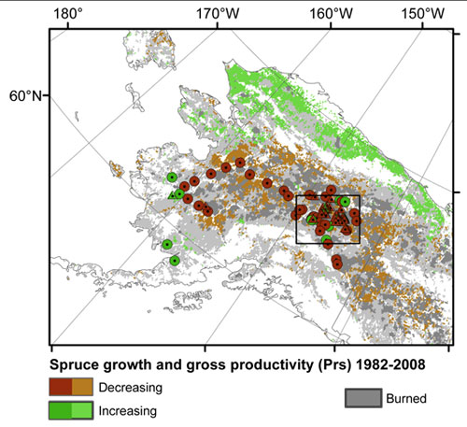
Flexibility will be needed to respond to climate change
www.sitnews.us

Slide 13
Discussion and Outreach
S&TC: 11 meetings, April 2014-Oct. 2015, incl. 16 scientific presentations.
IG: 4 meetings, April-May 2016
Technical experts: 48 forest researchers and managers in AK and Canada
Mailing list: 396 organizations, forest owners, Native corporations, local governments, businesses, legislators, agencies, individuals

Slide 14
Discussion and Outreach
Minutes, findings, and recommendations mailed to lists
Technical experts invited to scientific presentations
All meetings open
Comments reviewed and discussed with S&TC and IG

Slide 15
Recommendations
Combined S&TC and IG

Slide 16
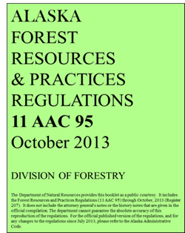
No change needed – C3am
No statutory changes needed
There are no recommended changes to the regulations on
Applicability (11 AAC 95.190)
Land use conversions (AS 41.17.110, 11 AAC 95.200. 11 AAC 95.375(b), 11 AAC 95.900(13)
Clearing of spruce (11 AAC 95.195)
Harvest unit planning and design (11 AAC 95.340)
Material extraction and disposal sites (11 AAC 95.325(d)(1))
Stocking numbers (11 AAC 95.375(b)(4) and (d)(2) and (3)
Extensions (.375(e))
Vegetative reproduction (.380(b))
Regeneration survey review (.385 (b))
Exemption allowance for dead and dying stands (.375(b)(2), (h))
Site preparation

Slide 17
Definitions – C22
The thresholds for applicability in the definitions of “commercial operation” and “commercial timber harvest” use board-foot measurements that don’t match harvest that are not focused on sawtimber. Add conversion factors to the Implementation Handbook (“purple book”) for cubic feet, cords, and tonnage.
Implementing
Best Management Practices
for Timber Harvest
Operations
June 2011
DIVISION OF FORESTRY
DEPARTMENT OF NATURAL RESOURCES
Please note:
This booklet is a work in progress. If you have any questions about sections in the booklet, please contact rick rogers, division of forestry:
Phone: 907-269-8473; email: r Rick will find answers to your questions, and keep a list of edits and clarifications that need to made in the future. By contacting him with questions, future revisions will make this booklet a more useful document. Thanks!!

Slide 18
Region | Thresh-hold in MBF | Approximate equivalents
 |  | MCF | Cunits | Cords | Bone dry tons | Green tons
II | 10 | 3.5 | 35 | 40 | White spruce – 40 | White spruce - 55
 |  |  |  |  | Birch – 55 | Birch -85
 |  |  |  |  | Aspen – 40 | Aspen – 70
 |  |  |  |  | Balsam poplar – 40 | Balsam poplar -60
III | 30 | 8 | 80 | 100 | White spruce – 95 | White spruce - 140
 |  |  |  |  | Birch – 130 | Birch - 205
 |  |  |  |  | Aspen – 95 | Aspen – 175
 |  |  |  |  | Balsam poplar – 100 | Balsam poplar -150

Slide 19
Conversion notes – green weight
Green weights vary widely depending on moisture content, and moisture content varies with species, season of harvest, and site conditions.
These are rules of thumb

Slide 20
Stocking standard for residuals
The IG recommends that the stocking standard chart in .375(b)(4) be corrected to close the gap between size classes:
Average DBH of Remaining Stand – Inches | Minimum Stocking Standard (trees per acre)
Greater than or equal to 9 (saw timber) | 120
6 to 8 (pole timber) | 170
1 to 5 (sapling) | 200
Notes:
Variation for low stocking density already allowed; some patchiness natural and beneficial for wildlife, continued recruitment
Landowners can shoot for 100% if desired

Slide 21
Stocking distribution – C8am
Given information on continued recruitment beyond the current deadlines for reforestation, requiring reforestation on 90% of the harvest area within 5-7 years is too stringent. Reforestation on 80% of the harvest area is recommended as a more appropriate minimum target based on field experience and the time frame for regeneration surveys defined in the regulations. Time extensions for achieving this standard may be considered under the existing procedures for extension in .375(e). (K-YES)
11 AAC 95.375 (d)(4). no more than 10 20 percent of the harvest area or contiguous areas may be below the stocking levels as set out in (1) or (2) of this subsec­tion.
Notes:
Continued recruitment
Time frame for surveys
Patchiness in natural stands
Patchiness benefits wildlife

Slide 22
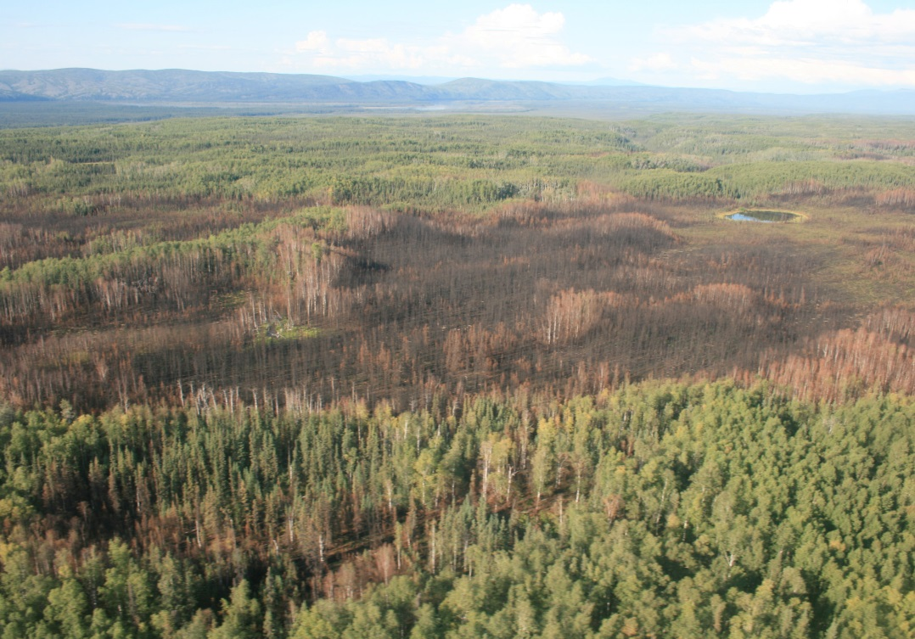
Stocking distribution – C6am
The stocking standard in .375(d)(4) should allow flexibility to reflect natural variation in stocking distribution prior to harvest. If the landowner plans to request a variation from this standard, pre-existing patchy conditions within harvest units should be documented in the DPO. (K-YES)
Alaska.usgs.gov
Notes:
Variation for low stocking density already allowed; some patchiness natural and beneficial for wildlife, continued recruitment
Landowners can shoot for 100% if desired

Slide 23
11 AAC 95.375 Reforestation requirement.
(c) In areas within Region II or III where the natural amount or distribution of stocking of commercial trees is below the minimum standards in (b)(4) before harvest, the division will consider a variation from the stocking levels required in (d) of this section. A request for variation under this section must be submitted through a DPO with documentation of pre-harvest stocking level and distribution.
Notes:
Note: the last sentence could be either in this section or in the DPO regulations.

Slide 24
Stocking distribution – C6am/C12
DOF should consider site conditions and non-stockable areas when reviewing requests for variation from the stocking distribution standard under 11 AAC 95.375(c). Low stocking may reflect both long-term site conditions and conditions that could be remedied by forest management actions. The target is to achieve a regenerated stand that is similar to or more fully stocked than the stand that existed prior to the harvest. (K-YES)
11 AAC 95.235. ((e)-new) In evaluating a request for a variation to reforestation stocking distribution standards under 11 AAC 95.375(d)(4) the state forester will consider non-stockable areas, and long-term and short-term site conditions.

Slide 25
Natural regen and DPOs – C1am
DPOs need more in-depth information where natural regeneration is the planned reforestation method. Information provided should address the indicators of likely natural regeneration success or failure in F14am and information on planned or completed site preparation or supplemental planting. DPO worksheet C (RII and III) (K-YES)
Seed bed conditions
Minimal soil disturbance in areas of vegetative reproduction
Seed source availability
Risk of vegetative competition is low (esp. grass)
Not spruce beetle infested
Not Tomentosus root rot
Risk of herbivory
See handout of DPO checklist

Slide 26
DPO REFORESTATION COMMITMENT - REGENERATION METHOD
[ ] Landowner will rely on natural regeneration of the site. Please provide known information on the following indicators of suitability for natural regeneration. Where boxes are checked “no”, please explain.
Yes No N/A Unknown
Seedbed and soil conditions suitable
[ ] [ ] [ ] [ ] Moss layers are shallow (<4”) or absent
[ ] [ ] [ ] [ ] Where birch or spruce regeneration is targeted, exposed mineral
soil will exist on at least 25% of the harvest area and is well-distributed across the unit
[ ] [ ] [ ] [ ] Where aspen regeneration from suckering is targeted, root
damage will be minimal and soil exposure will encourage warming
Seed/vegetative reproduction sources available
[ ] [ ] [ ] [ ] Exposure to prevailing winds, if known
[ ] [ ] [ ] [ ] Adequate seed trees exist within 3 tree heights of the reforestation site for spruce or within 2 tree heights for birch
[ ] [ ] [ ] [ ] Where spruce regeneration is targeted, large seed crop in year prior to harvest or current year
[ ] [ ] [ ] [ ] Where vegetative reproduction is targeted the harvest area contains sufficient, well-distributed
birch, aspen, poplar, cottonwood, red alder, or other species known to revegetate vegetatively as approved by DOF.
Competition and infestation risk
[ ] [ ] [ ] [ ] Calamagrostis (bluejoint grass) is not visually evident. If Calamagrostis is visually evident, describe abundance
and distribution.
[ ] [ ] [ ] [ ] Equisetum (horsetail) is present prior to harvest
[ ] [ ] [ ] [ ] The site is not currently subject to intense herbivory due to peaks
in the hare cycle, dense moose populations, or scarcity of browse in the surrounding landscape.
[ ] [ ] [ ] [ ] Existing stands are not infested with bark beetles (Dendroctonus or Ips)
[ ] [ ] [ ] [ ] Where spruce regeneration is targeted, harvest areas are free of known incidence of Onnia tomentosus root rot.
Note: If likely competition or other factors indicate challenges for natural reforestation, prompt reforestation through site preparation and/or artificial regeneration is recommended to ensure success and minimize costs.
[ ] Landowner requests an extended period for natural regeneration under 11 AAC 95.XXX
Notes:
This version doesn’t include explanatory notes – see packet version
For vegetative reproduction, allow other species known to reproduce vegetatively as approved by the Division
Calamagrostis cover >1-2% indicates grass may expand rapidly after harvest without treatment
Tomentosus – describe extent; design reforestation to minimize continuation or spread

Slide 27
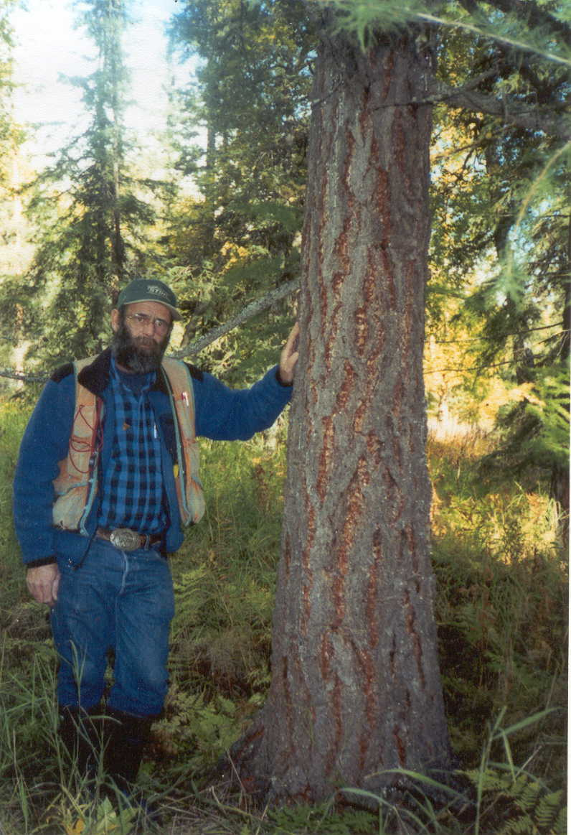
DPOs, cont. –Supplement C (II-III)
IG: allow other species with DOF approval
Tree species considered by DOF for stocking purposes include Sitka spruce, white spruce, Lutz spruce, aspen, balsam poplar, western black cottonwood, and paper birch or other commercial species approved by the Division
AK’s largest larch (2002)
75 ‘ tall, 16.5 DBH at 50 yrs. Wasilla. From John Alden

Slide 28
DPOs cont.
IG: Add checkbox for season of harvesting
DPO – Harvest & Silvicultural Characteristics
FOR REGION II OR III:
[ ] Winter harvest only
[ ] Non-winter harvest only
[ ] All-season harvest

Slide 29
DPOs and FLUPs
The information required in the DPO, Reforestation Commitment, and Supplement C should also be included in FLUPs for state timber sales.
State of Alaska
Department of Natural Resources
Division of Forestry
Region III – Delta
Forest Land Use Plan
Mississippi Fire Salvage #1
NC-1510-D
February 24, 2014

Slide 30
Natural Regen and DPOs: Training – C7
Use of the indicators in F14am to prepare and review DPOs and requests for variations will require training for Division of Forestry staff, landowners, and operators. Training (K-YES)

Slide 31
Natural regeneration – C23
Clarify that 11 AAC 95.380(a) applies to natural regeneration from seed. (Section .380(b) applies to vegetation reproduction.) (K-YES)
11 AAC 95.380. (a) If a forest landowner in Region II or III intends to rely on natural regeneration from seed for reforestation, the forest landowner shall ensure a seed source of well-formed, vigorous trees of commercial tree species.

Slide 32
Natural regeneration – C5am
Where natural regeneration is the selected method of reforestation, based on information in the DPO, DOF may allow a period of up to 12 years for natural regeneration in stands where the indicators show a high likelihood of regeneration success within that period.
11 AAC 95.375(d)(new §§) In Region II or Region III, the division may allow a period of up to 12 years for natural regeneration where site conditions indicate a high likelihood of regeneration success within that period based on information in the DPO.
Notes:
Continued recruitment
Env. And economic benefits to Natural Regeneration
Indicators for likely success

Slide 33
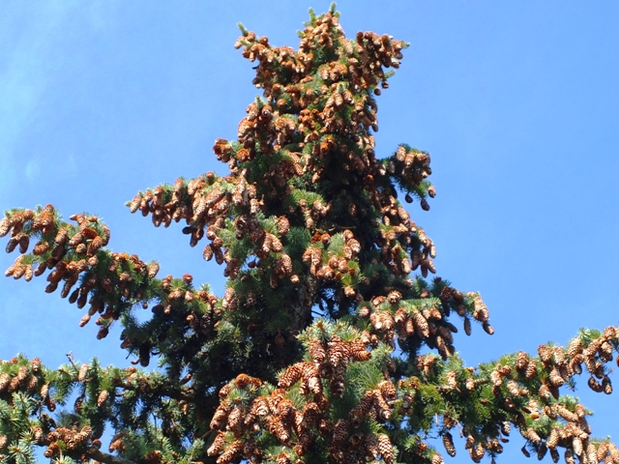
Natural regen. – C5am cont.
A 12-year period would typically encompass at least one excellent white or Lutz spruce seed crop in RII-III, and one or two smaller, but adequate spruce seed crops, as well as multiple hardwood seed crops.
This would also provide enough time for sufficient hardwood stems to escape browsing in the absence of intense browse pressure.

Slide 34
Natural regeneration – C5am/10am
Where a 12-year period is allowed for natural regeneration
Require a regeneration report after 5 years to ensure that the stand is on a trajectory that is likely to be successful. If the indicators no longer support an extended period for natural regeneration, corrective measures may be required.
IG: Allow other forms of documentation

Slide 35
11 AAC 95.385. (a) A forest landowner in Region II or III shall conduct a regeneration survey and file a regeneration report with the DOF. […] A regeneration survey or alternative documentation must be conducted in a manner acceptable to DOF. In an area reforested by natural regeneration, planting, or artificial seeding, a regeneration report shall be submitted within […]
2) 7 yrs after timber harvest in Region II or III. If the period for natural regeneration is extended to 12 years under 11 AAC 95.375(d)(new), a regeneration report must be submitted
a) within 5 yrs after the timber harvest to determine whether the reforestation requirements are likely to be met, and
b) within 12 yrs after the timber harvest to document that the standards have been met.
If either report or field verification shows deficiencies in reforestation, DOF will direct the forest landowner to correct them.

Slide 36
Artificial regeneration – C13am
Natural and artificial regeneration can both be beneficial in achieving reforestation goals. When artificial regeneration is chosen, given changing climate conditions, sound options include:
1) Using seed/seedlings of native species from a similar latitude, climatic area, and elevation,
2) Using seed/seedlings of native species from similar conditions in a mix with seed/seedlings from up to 10° latitude south of the planting site. Seeds from farther south or other locations may be used if they have been demonstrated to be successful. (F19, F21) (K-YES)
Notes:
Note: CA carbon offset protocols have provision similar to (2)

Slide 37
11 AAC 95.375. (f) Unless otherwise authorized by the division, seeds used for reforestation must be
(1) from a similar latitude, climatic area, and elevation as the harvested area, or
(2) a mix of seed for native species from similar conditions with seed from up to 10° latitude south of the planting site. Seeds from other locations may be used if they have been demonstrated to be successful and are approved by the Division.

Slide 38
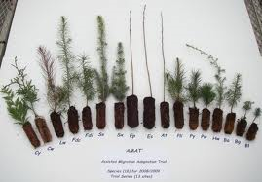
Artificial regeneration – C13am, cont.
3) Including species that have been demonstrated to naturalize in Alaska without becoming invasive, including lodgepole pine and Siberian larch. Purple book
4) Providing for systematic evaluation of operational-scale assisted migration trials both within and among species.
Purple book (11 AAC 95.235(c) allows for scientific experiments)
(K-YES)
Assisted migration trial www.unbc.ca

Slide 39
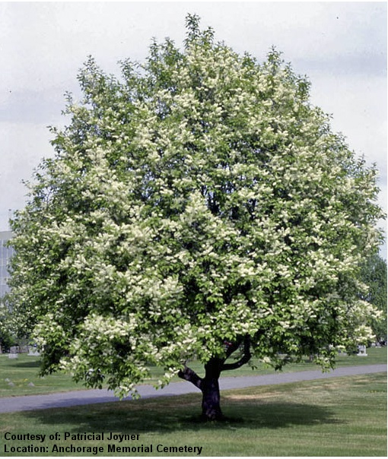
Artificial regeneration – C14
Known invasive species, including species rated higher than 50 on the Alaska Exotic Plants Information Clearinghouse (AKEPIC) list of invasive species should not be planted. For example, bird cherry (Prunus padus, rated 74) should not be planted as it has been documented to be harmful to native ecosystems. (K-YES)
11 AAC 95.375 (new§§) Known invasive tree species shall not be planted.
Use purple book to establish AKEPIC rating >50 as the measure

Slide 40
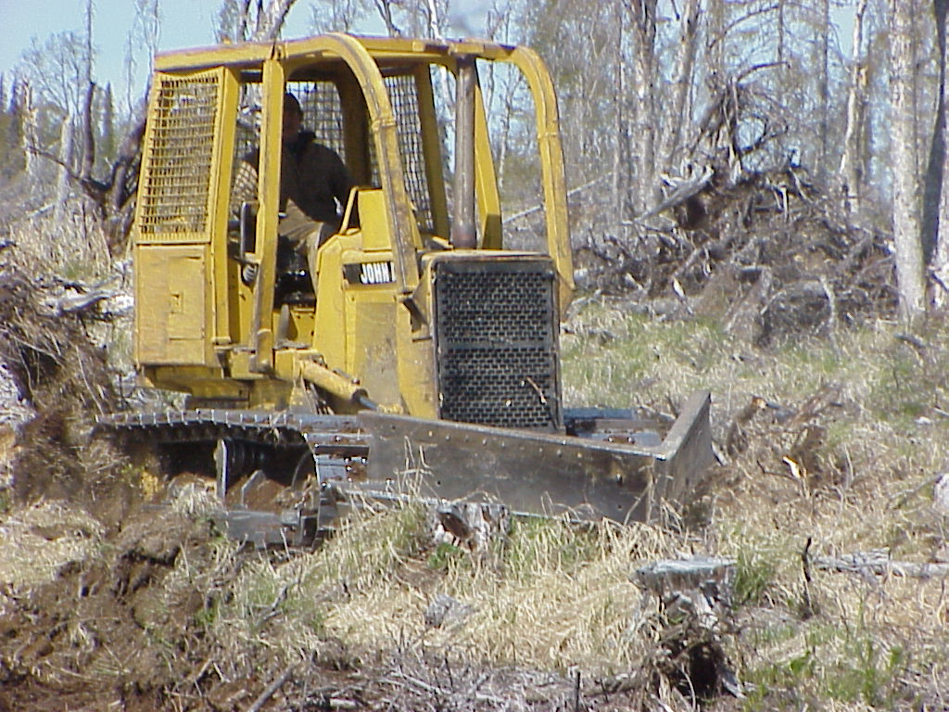
Site preparation – C16
Mechanical site preparation should avoid driving heavy equipment over known den sites greater than 12” in diameter (e.g., dens for fox, wolves, and bears). Education and voluntary cooperation with private landowners under AS 41.17.910 (Wildlife Habitat on Private Land); FLUPs/contracts (K-YES)
John Winters, DOF

Slide 41
Exemption methods – C9am
New technologies such as satellite imagery, aerial imagery, or lidar in combination with hyperspectral scanning offer additional options for assessing areas of dead and dying trees. Consider methods of survey other than the method listed in .375(g) and (h) that offer adequate review of requests for reforestation exemptions under those sections. (K-YES)
Notes:
DOF may accept other documentation under the reg, but only “where the extent of damage is obvious.”

Slide 42
11 AAC 95.375. (g) To apply for an exemption from reforestation requirements under (b)(2) or (c) of this section, a landowner must request an exemption in the reforestation section of a detailed plan of operations under 11 AAC 95.220(10) or a change in operations under 11 AAC 95.230 and must demonstrate that the affected stand is significantly composed of insect and disease-killed, fire killed, wind thrown, or fatally damaged trees. […] [THE DIVISION MAY ACCEPT] Other documentation or field evidence approved by the division may be used in lieu of sampling [IN AREAS WHERE THE EXTENT OF DAMAGE IS OBVIOUS].

Slide 43
Invasive species – C17 IG
All tree seeds or seedlings imported into AK from outside the state should be certified free of pests, diseases, and noxious weeds. DOF and DAg should coordinate to implement this recommendation; options include existing phytosanitary certificates (e.g., for imports from Canada), state certifications (e.g., OR shipping certificates), or certificates from nurseries that seeds or seedlings are free of pests, diseases, and noxious weeds. (K-YES)
Notes:
Plants, insects, and diseases

Slide 44
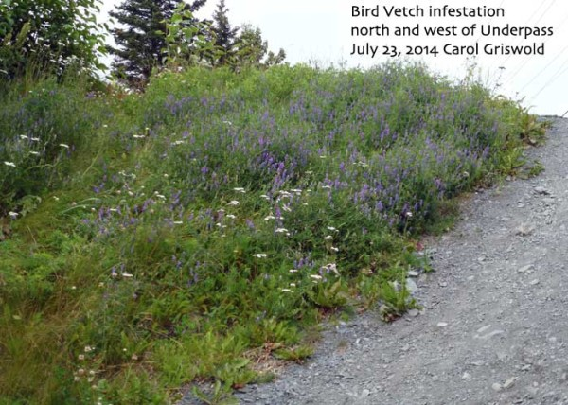
Invasive species – C18
Equipment used for scarification or planting can introduce invasive species to harvested areas. The goal is to prevent introduction of species that could inhibit reforestation; once a species is established eradica- tion is more difficult.
(K-YES)

Slide 45
Invasive species – C18 IG
Encourage voluntary use of the following guidance:
Scout for invasive plants before performing work in an area.
ID known locations of invasive plants, report new locations, and make use of local knowledge and groups if available.
Avoid working in areas with invasive plants, and work from areas without to areas with invasive plants if that is not possible.
Time operations to prevent/reduce seed production or dispersal.
Revegetate with native, local, and/or noninvasive species.
Use certified weed-free materials, incl. seed mixes, gravel, topsoil, hay/straw, erosion control tubes, etc.
Clean vehicles and equipment regularly, using high pressure washer and physical removal, before leaving areas with invasive species. (K-YES)

Slide 46
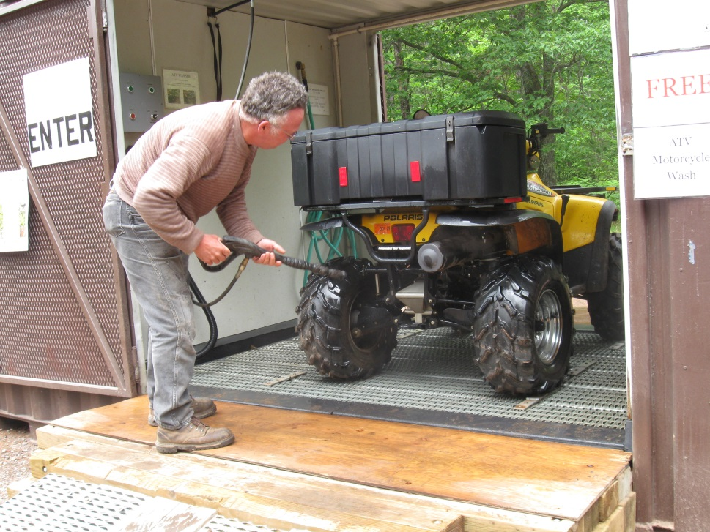
Invasive species – C19 - Training
The agencies should provide information and training about known invasive species, best practices to prevent their spread, and where known, safe locations for washing vehicles. (K-YES)
www.fs.fed.us

Slide 47
Other Region II-III training needs – C11
Emphasize the importance of capturing and synthesizing institutional knowledge on the role of scientific information in developing the FRPA and regulations, identifying research priorities, and exercising professional discretion in applying the standards. Conveying the reasons for developing the standards to agency staff, landowners, and operators is particularly important in the context of losses of experienced staff.
Compile and document staff knowledge, train new employees, and develop, make available, publicize training materials and get copies to the IG, and work with Coop Extension to help warehouse information. (K-YES)

Slide 48
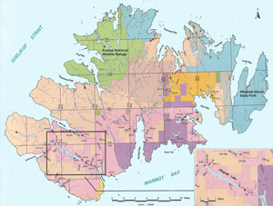
Kodiak applicability
Those recommendations that are likely to be applicable to the Kodiak-Afognak area are noted by K-YES.
The notes on Kodiak applicability are not based on the same extensive review as that conducted for Regions II-III.
Review recommendations with stakeholders in the Kodiak-Afognak area before deciding whether these recommendations apply to that area.

Slide 49
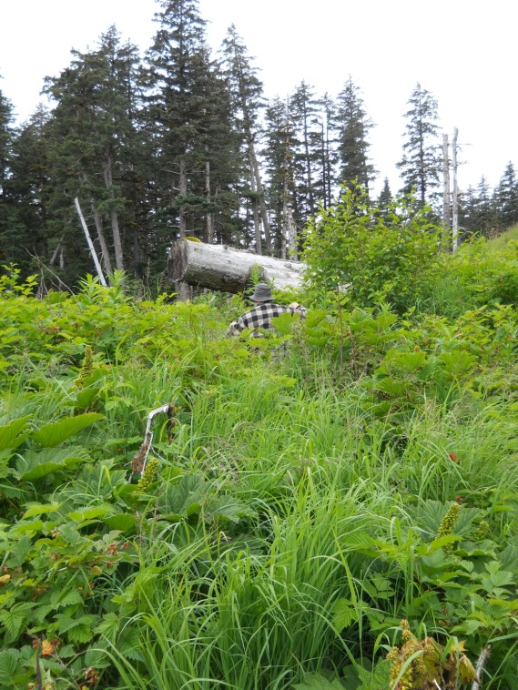
Natural Regeneration - Kodiak
This section is less applicable to Kodiak-Afognak. Natural regeneration is generally unsuitable because of
1) widespread competition from grass, salmonberry, and other vegetation, and seedling losses to herbivores
2) single-species stands of Sitka spruce, e.g., there are no hardwood pioneer species to regenerate from abundant seed
3) at present, harvesting is on an industrial scale with extensive clearcuts that are better suited to artificial regeneration
4) Replanting following likely failure of natural regeneration is costly

Slide 50
Next steps

Slide 51
Next Steps
If endorsed by the Board,
Adopt the proposed regulatory changes
Incorporate additions to the purple book
Incorporate changes into DPO forms and FLUPs
Develop and provide training
Implementing
Best Management Practices
for Timber Harvest
Operations
June 2011
DIVISION OF FORESTRY
DEPARTMENT OF NATURAL RESOURCES
Please note:
This booklet is a work in progress. If you have any questions about sections in the booklet, please contact rick rogers, division of forestry:
Phone: 907-269-8473; email: r Rick will find answers to your questions, and keep a list of edits and clarifications that need to made in the future. By contacting him with questions, future revisions will make this booklet a more useful document. Thanks!!
STATE OF ALASKA
DEPARTMENT OF NATURAL RESOURCES
DIVISION OF FORESTRY
NOTICE OF OPERATIONS
DETAILED PLAN OF OPERATIONS SUMMARY
xxxxxxxxxxxx_______________________________________________________________________________________________________________
Mmmmmmm______________________________________________________________________________________________________________________________________________________________________________
XXXXXXXXXXX_______________________________________________ xxxxxx_______________________________________________________bbbbbbbb___________________________________________________________________________________________________________________qqqqqqqqqqqqqqq____________________________________________________________________________________________________________wwwww_______________________________________________________________________________________________________________________________________________________________________________________________________________________________________________
State of Alaska
Department of Natural Resources
Division of Forestry
Region III – Delta
Forest Land Use Plan
Mississippi Fire Salvage #1
NC-1510-D
February 24, 2014

Slide 52
Planning & draft regs
S&TC, IG, & BOF
Agency AGO Attorney reviews draft & DOL opens file
Public notice & public comment (incl. BOF)
Admin. Reg. Review Comm. review
Gov. Office review
DOF sends to DOL
DNR revises/adopts regs
AGO agency attorney legal review
AGO regulations attorney legal review
Lt. Gov. reviews & files
ALASKA REGULATIONS ADOPTION PROCESS
Effective in 30 days
Published in AAC & sent to ARRC

Slide 53
Next Board Meeting
Review research priorities and cooperative planning recommendations

Slide 54
QUESTIONS ???

